Slide 1
Installation Guide
(Eclipse Plug-in –
Anyframe Common 2.0.1
on Eclipse 3.5)
2009. 07. 20
CODELABOR
Shin Sang Jae (codelabor@gmail.com)

Slide 2
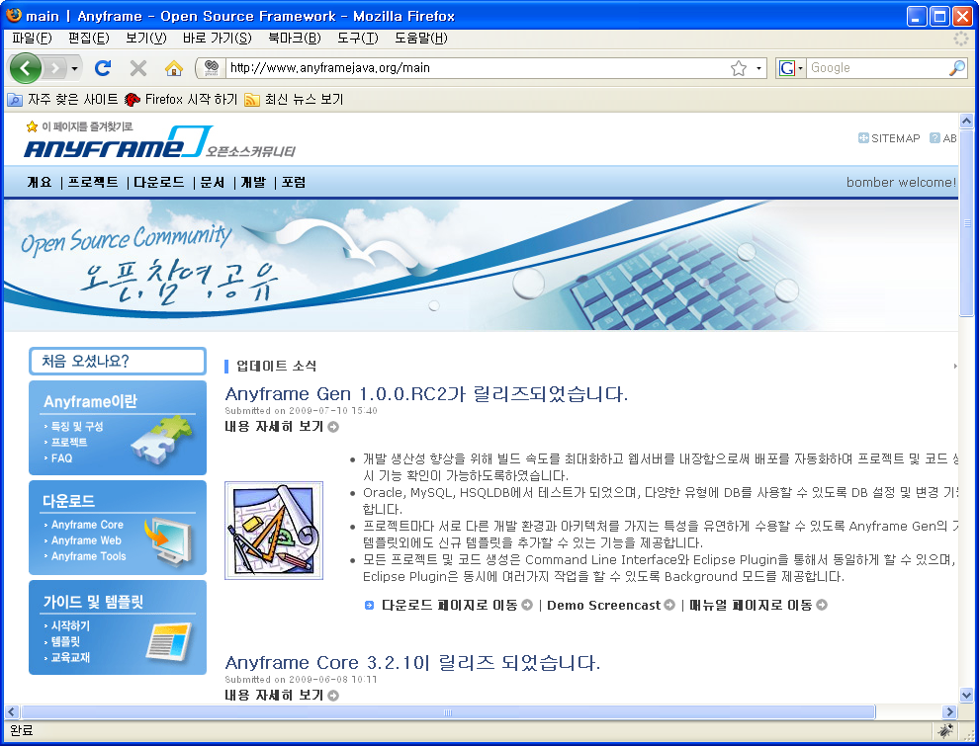
Anyframe Common
Site
Officical Site: http://www.anyframejava.org/

Slide 3
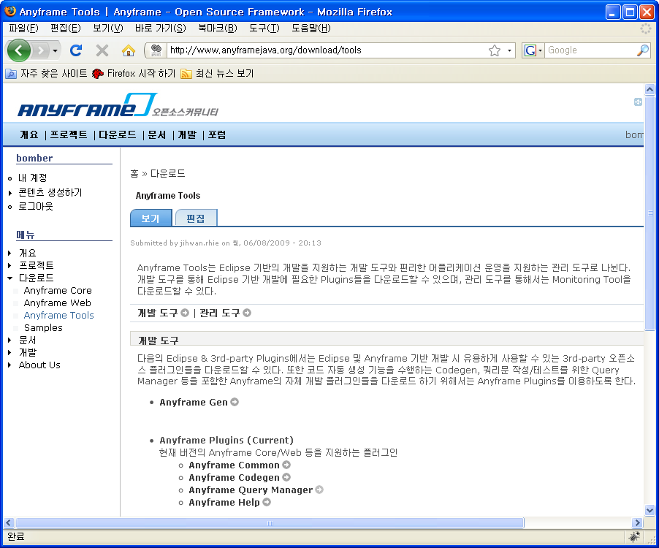
Anyframe Common
Download
Download Site URL: http://www.anyframejava.org/download/tools/anyframe/common
Download File: anyframe.plugins.common-2.0.1-bin.zip

Slide 4

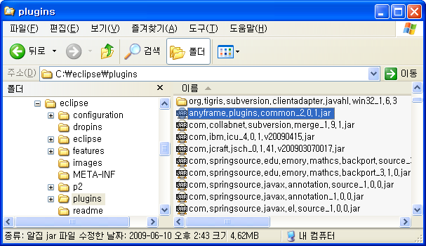

Anyframe Common
Unzip / Install
Unzip
Install into Eclipse plugin directory
  Directory: C:/eclipse/plugins

Slide 5
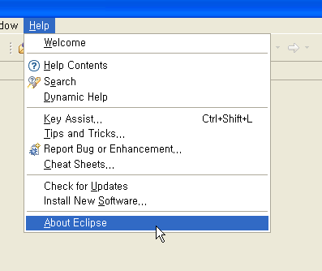
Anyframe Common
Software Updates
Restart Eclipse
Menu
  Help > About Eclipse

Slide 6
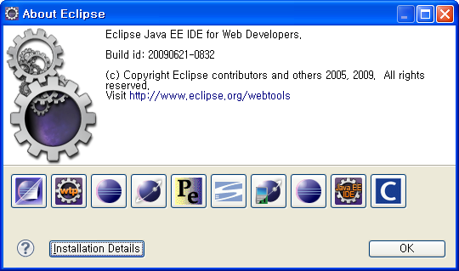
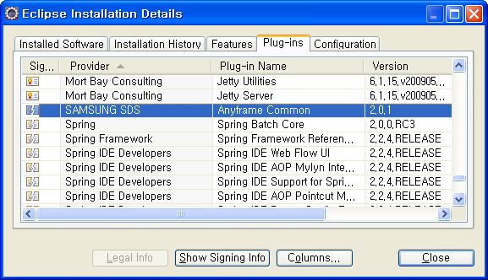
Anyframe Common
Software Updates
About Eclipse Window
  Install Details
Eclipse Installation Details Window
  Plug-ins

